Slide 1
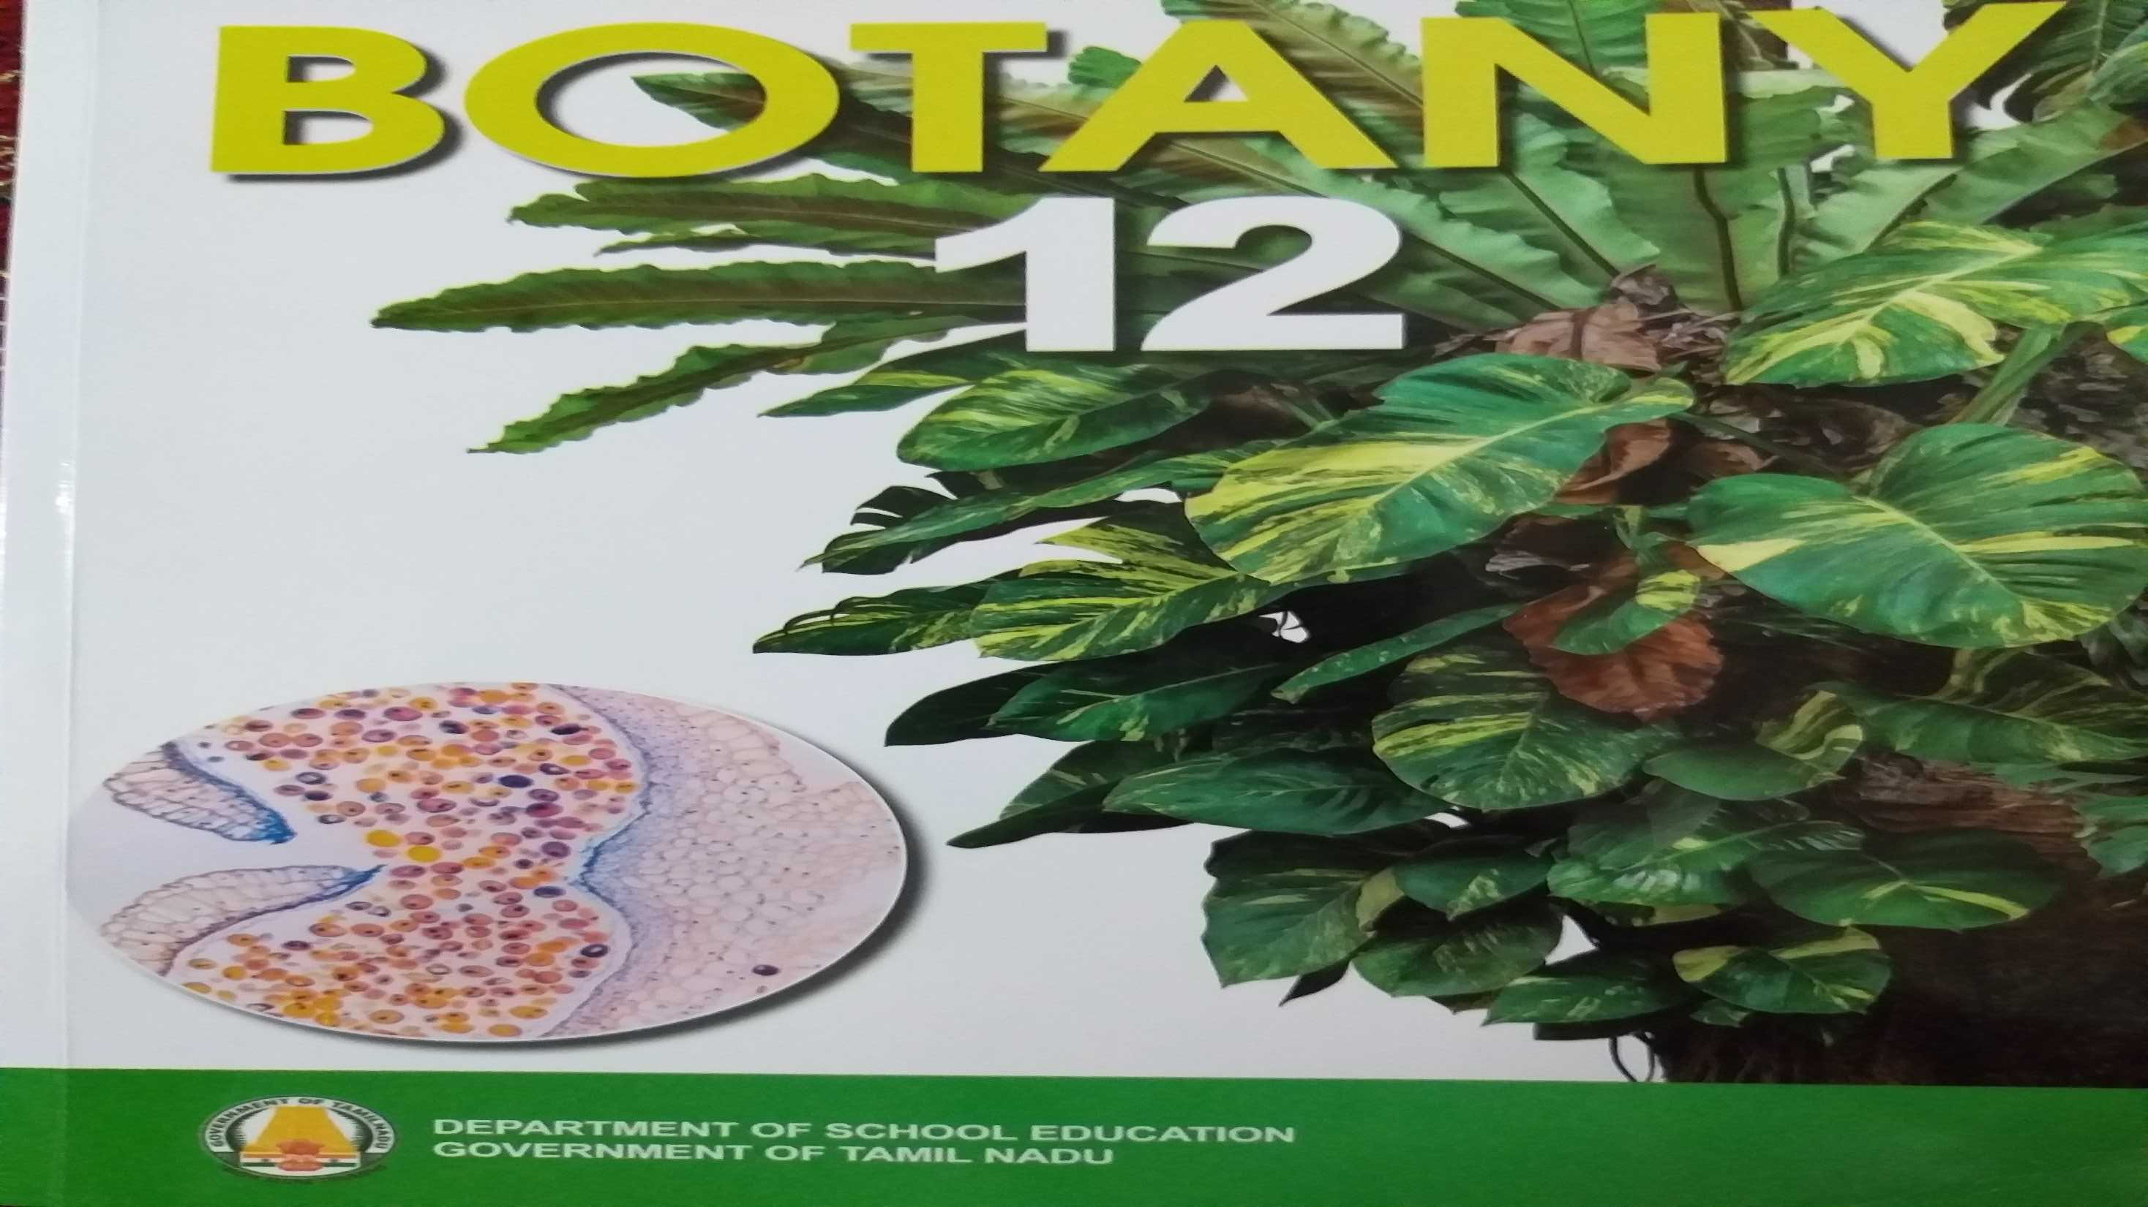

Slide 2
DNA Metabolism in Plants
DNA Replication
DNA Repair
Recombination

Slide 3
EUKARYOTIC DNA REPLICATION
Origin of replication
ARS Sites
Helicase
Topoisomerase
DNA polymerase α delta epsilon
Leading strand
Lagging strand – Okazaki Fragments
Telomerase
The energetics of DNA Replication

Slide 4
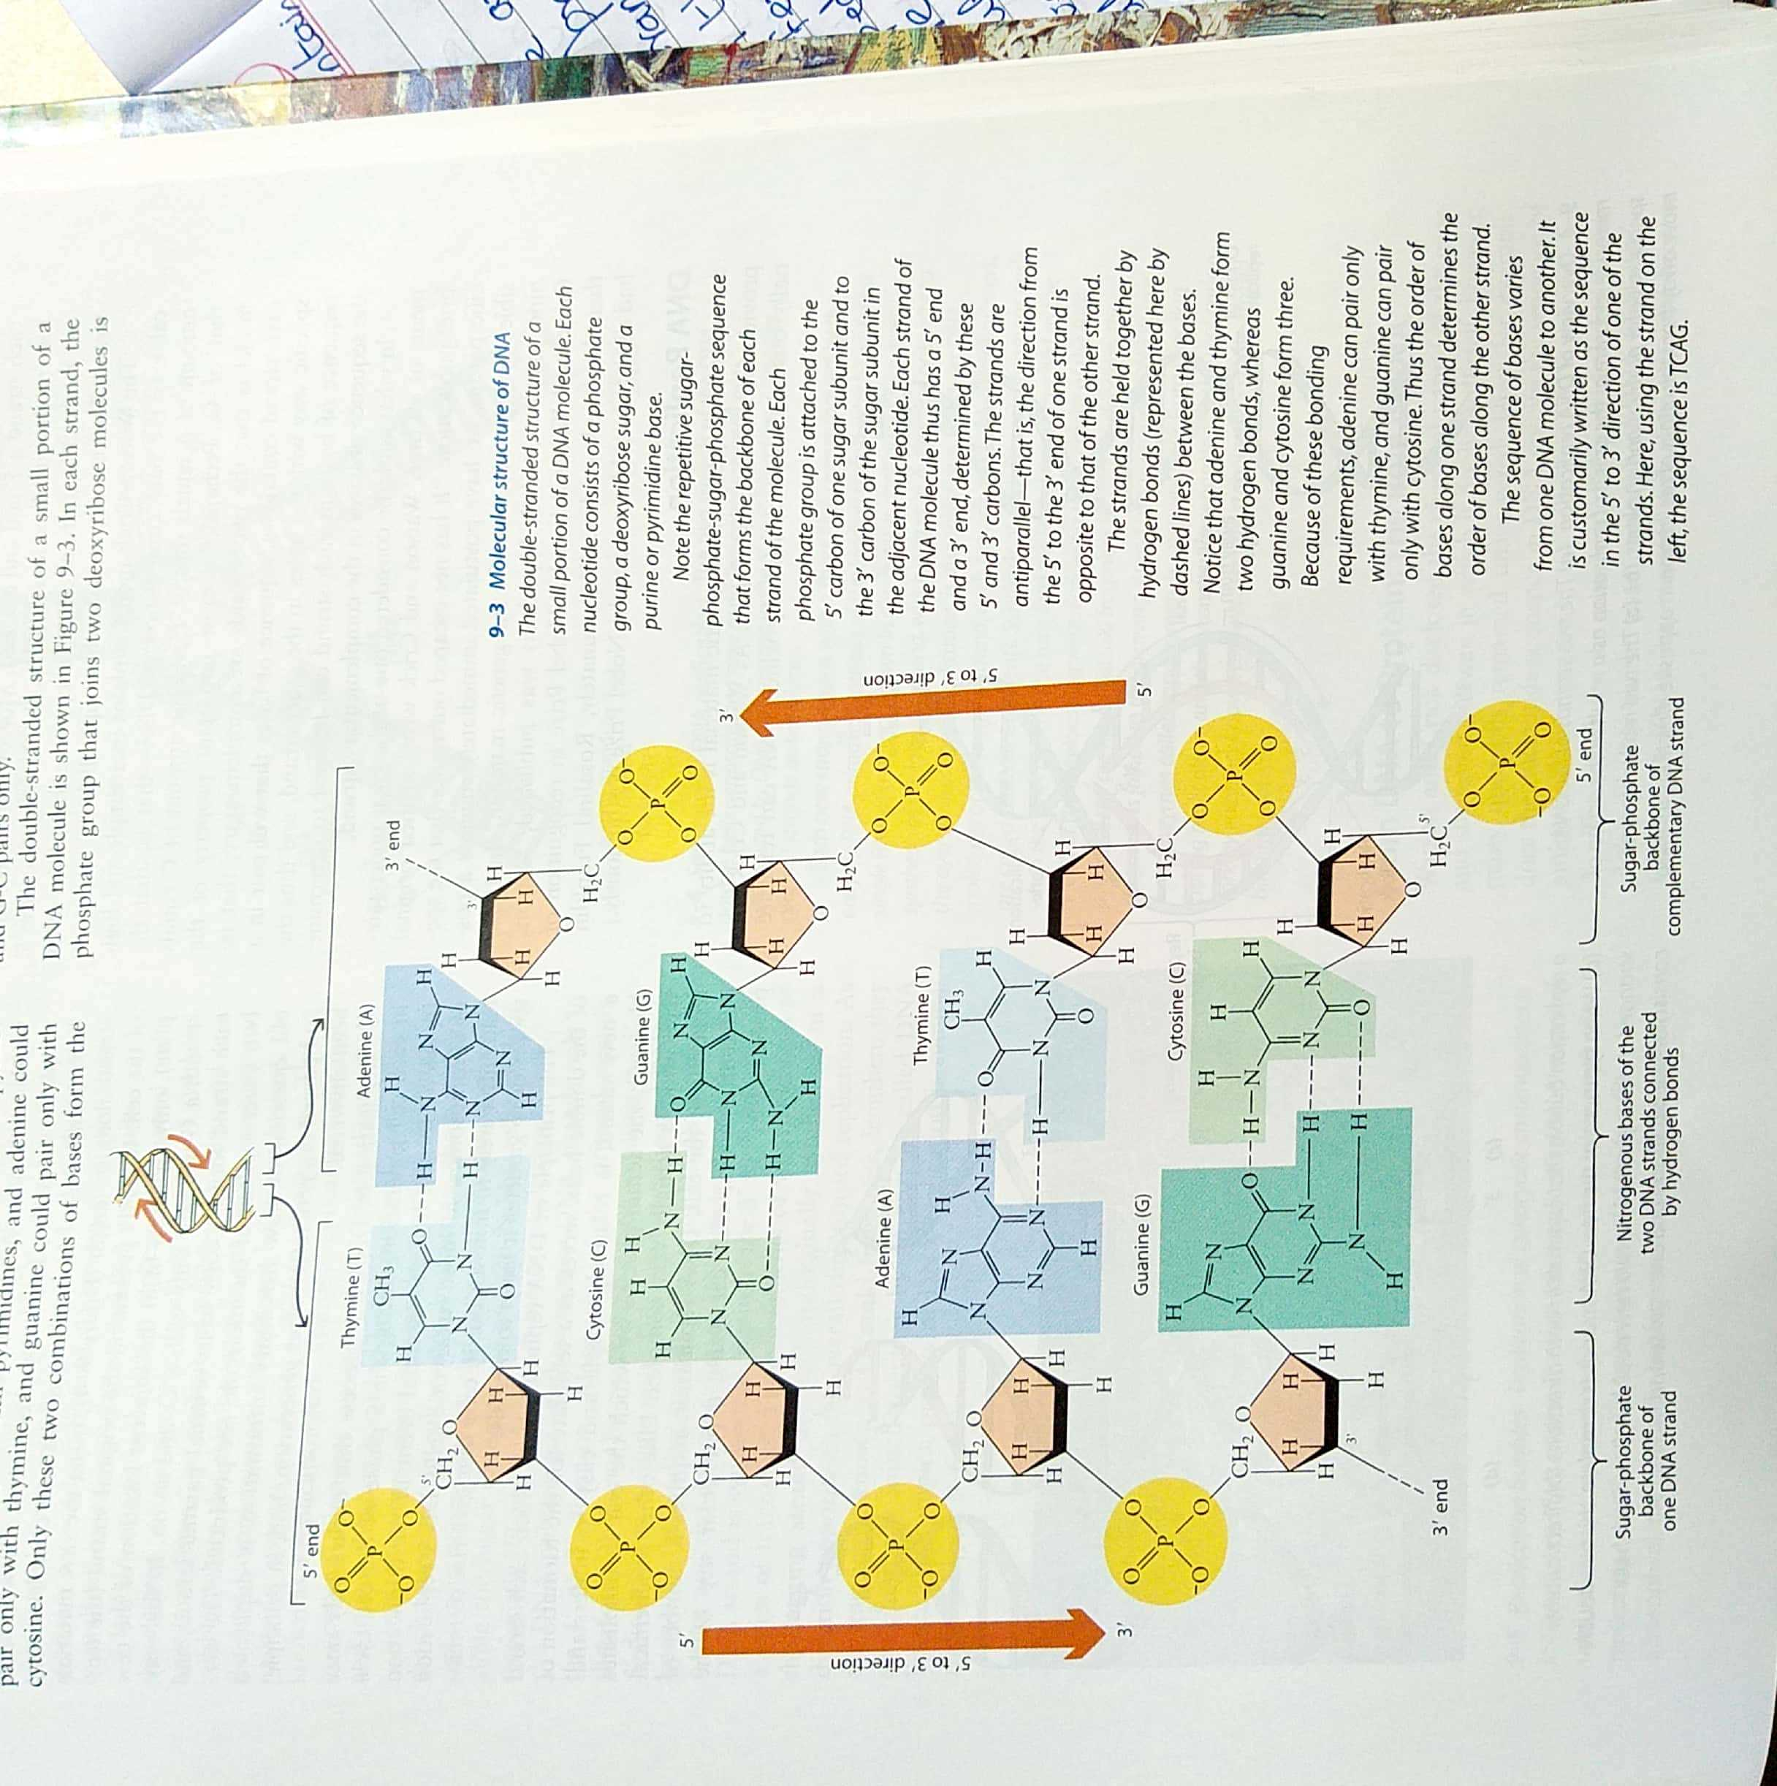

Slide 5
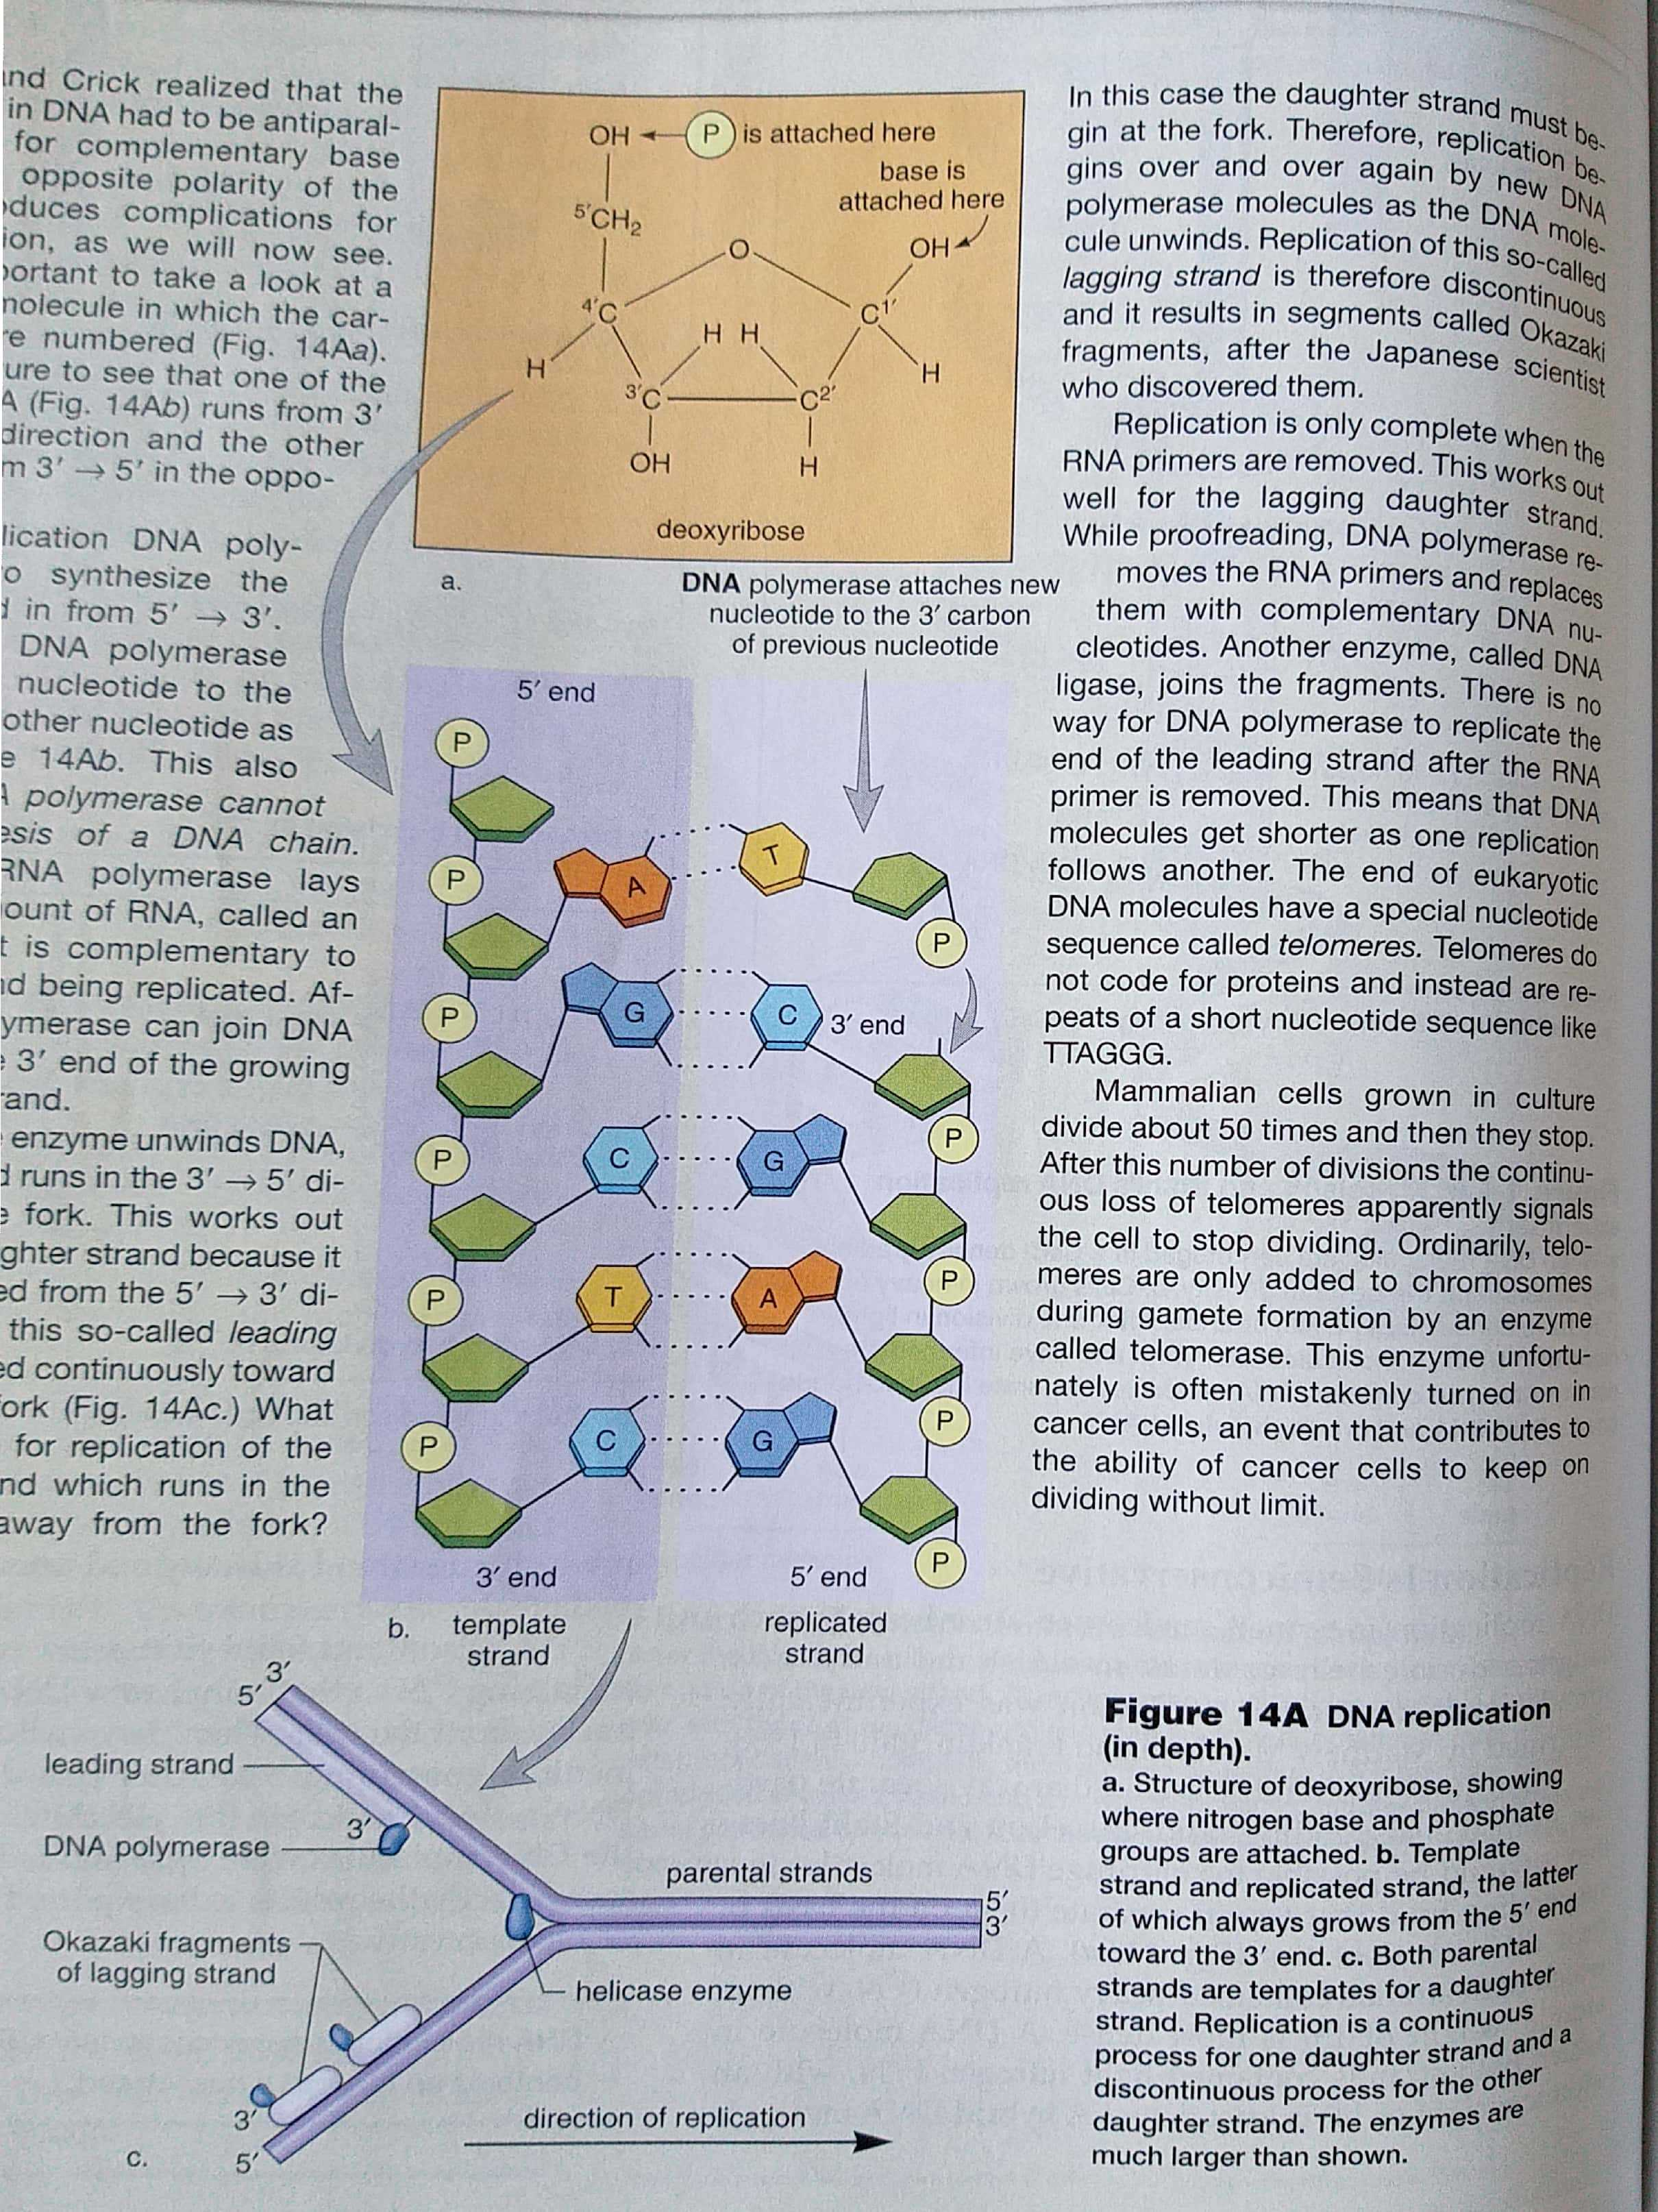

Slide 6
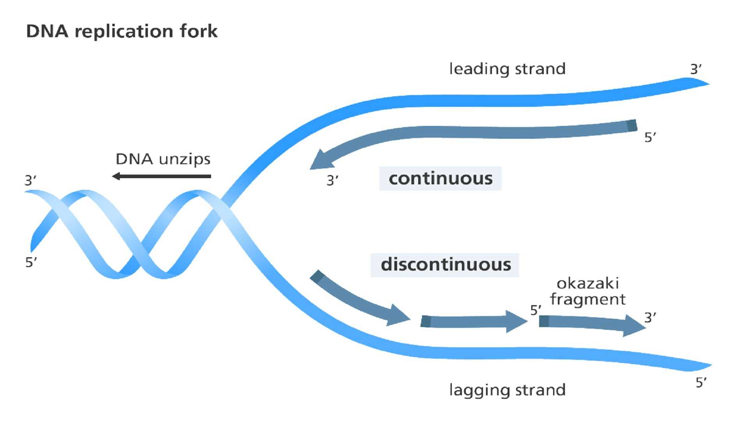

Slide 7
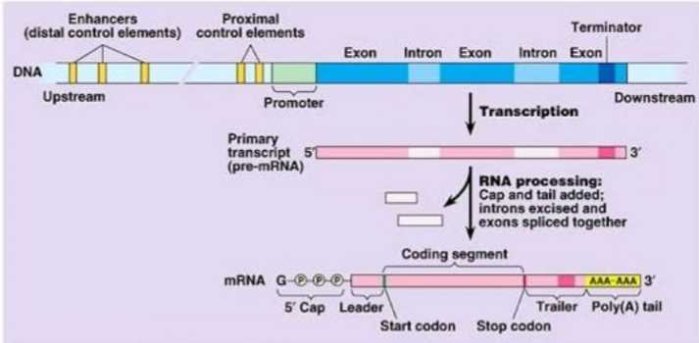
PROTEIN SYNTHESIS
Transcription
Translation
TRANSCRIPTION
Nucleus
Template strand
Promoter
Enhancer
Silencers
Mediators
RNA Polymerase I, II, III
Molecular mechanism of
RNA Modification:-
- Capping
- Tailing
- Splicing.

Slide 8
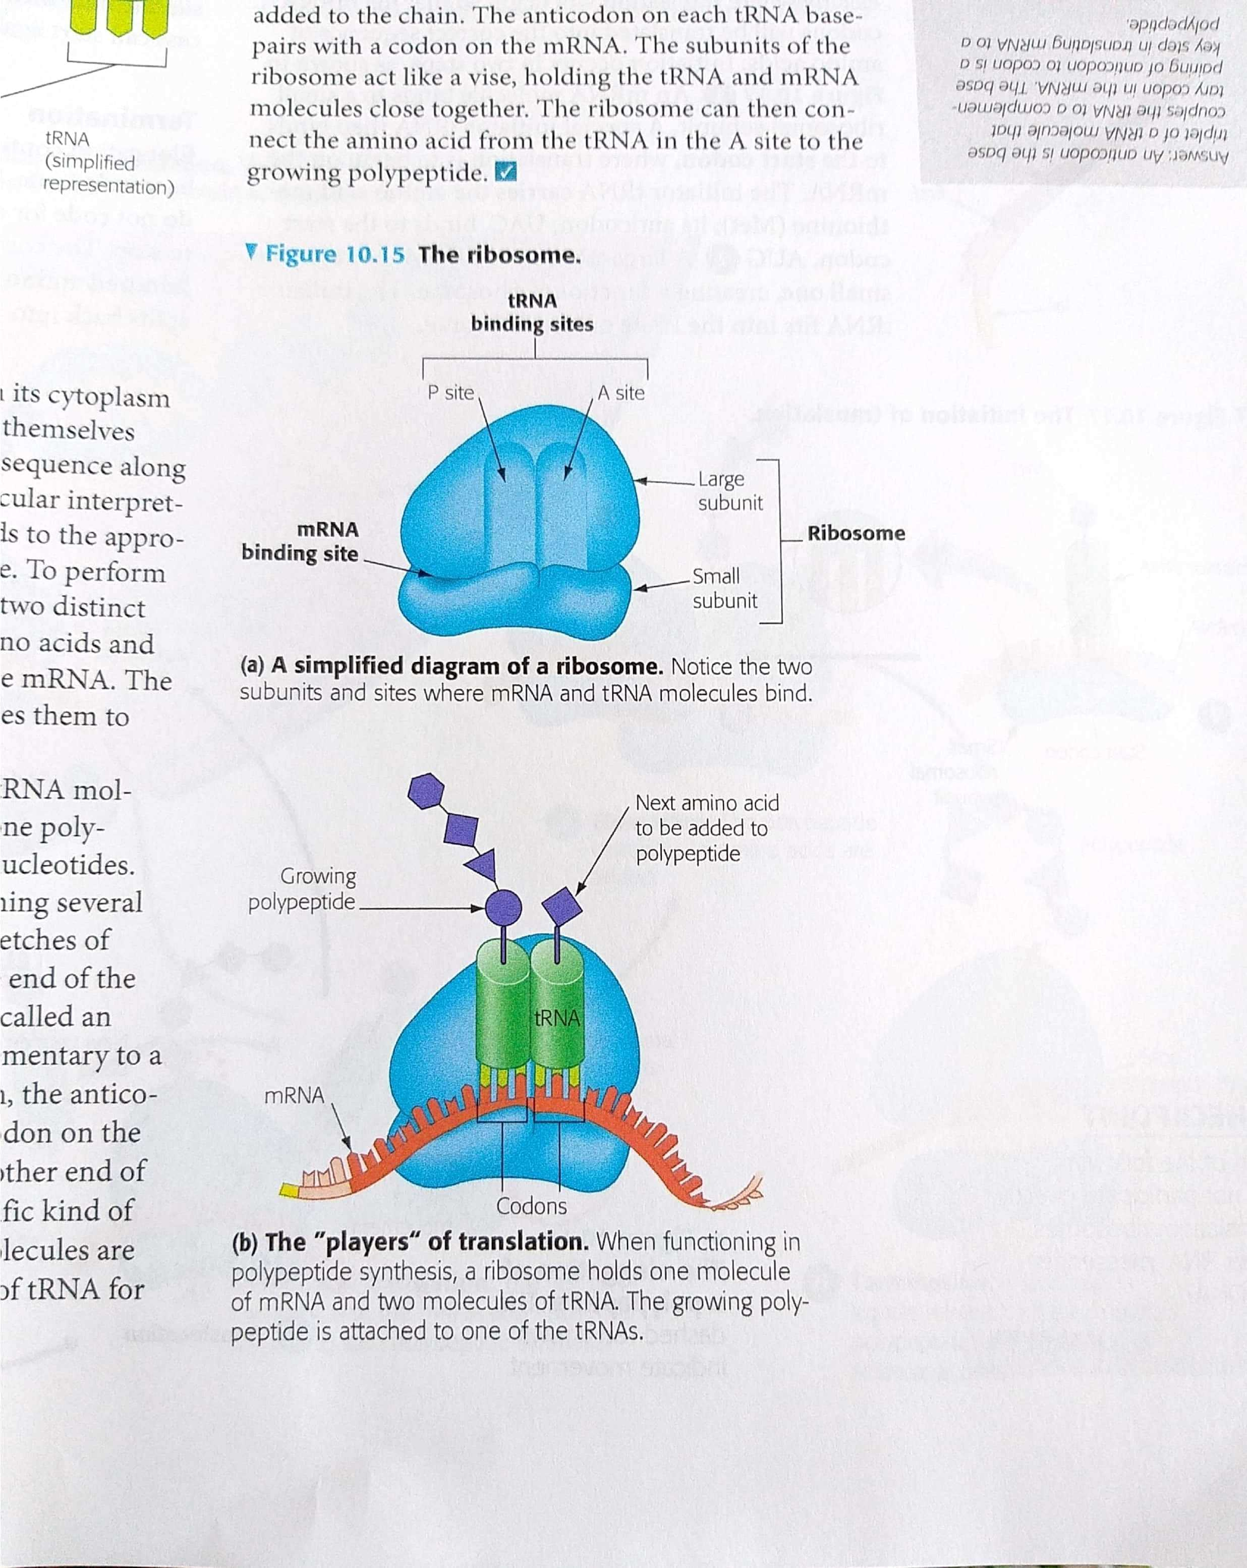
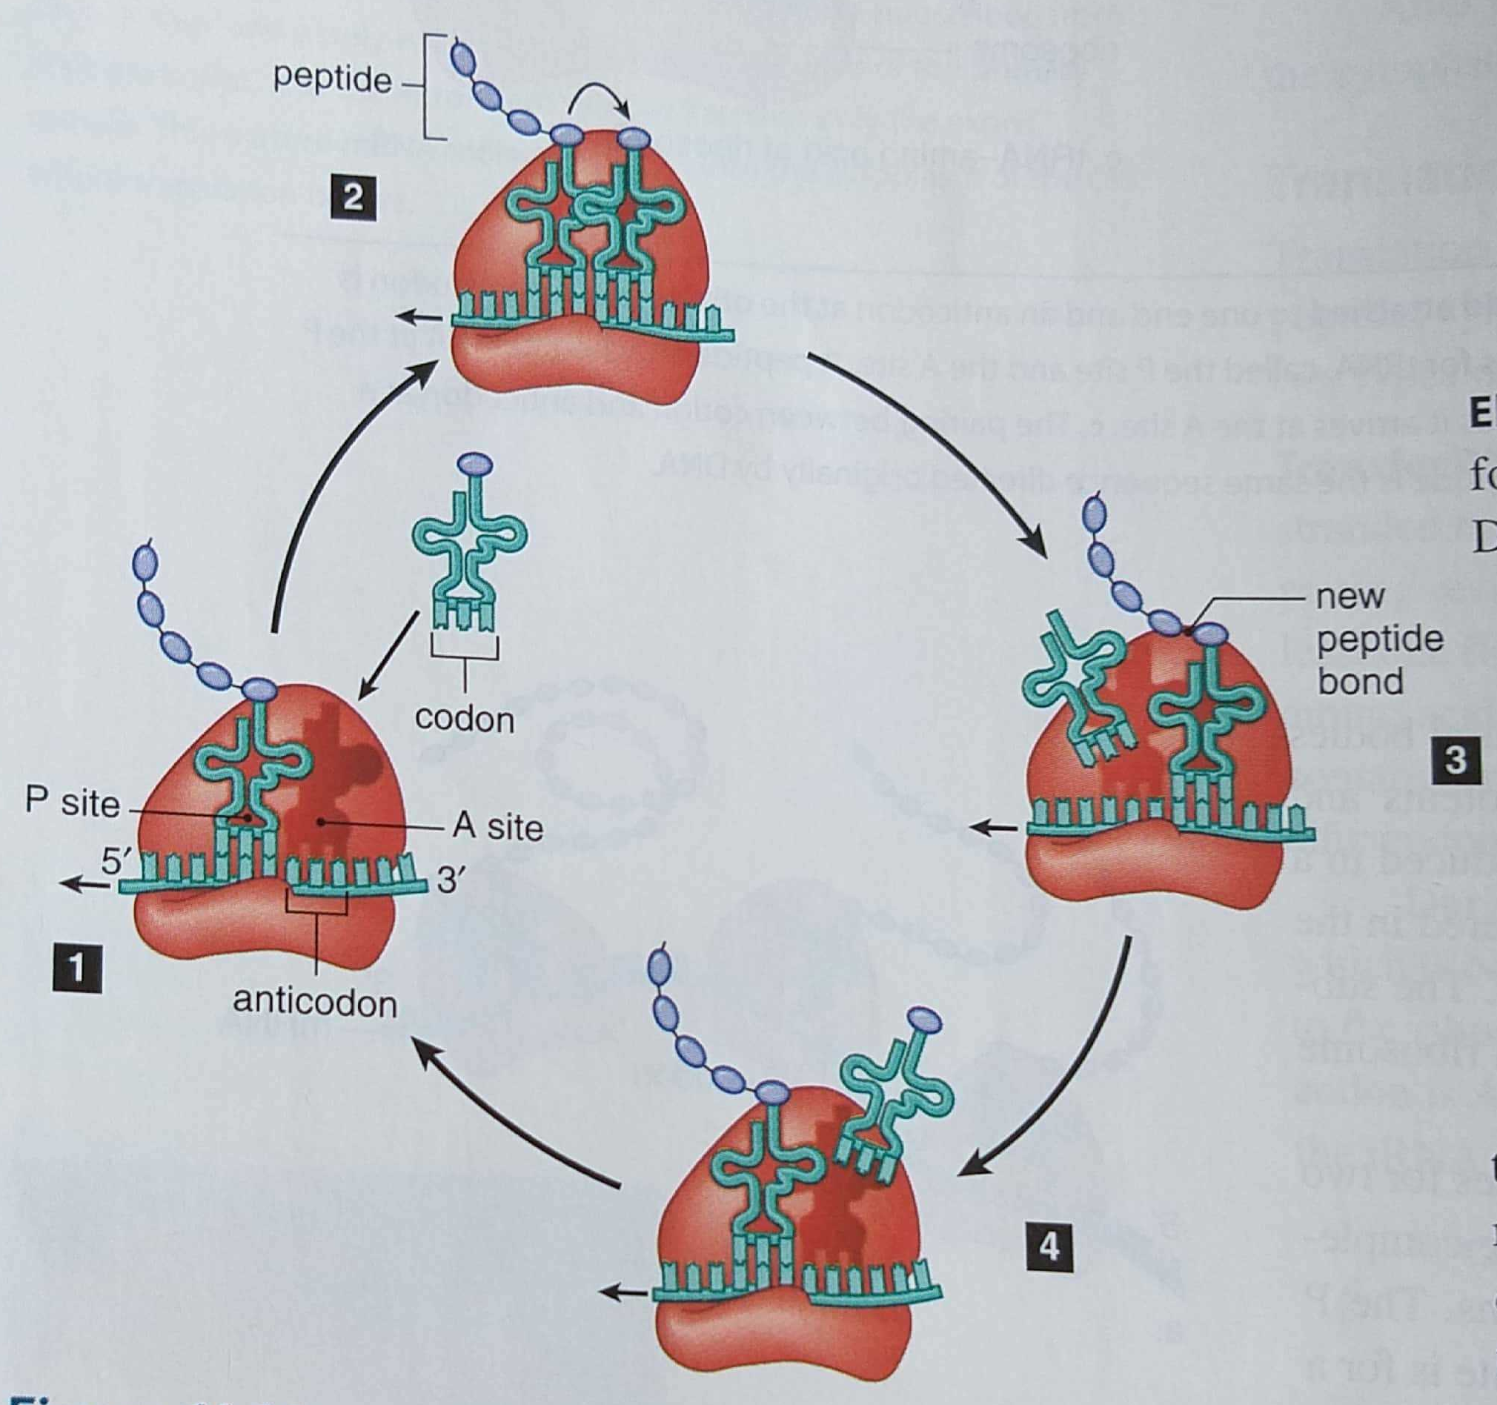
TRANSLATION
Cytoplasm
Ribosomes – P site & A site
AUG Start codon
Translators of genetic code – t-RNA
Translocation
Termination codon
Release factors

Slide 9
Alternative splicing in plants
Regulates gene expression to over come stress in plants.
Multiple protein isoforms are produced.
RNA Editing in Plants.
Post-Transcriptional RNA processing
Chloroplast, Mitochondria
Restoration of Codons phylogenetically conserved amino acid
Jumping genes, Hopping genes, Barbara McClintock “Mobile controlling elements” Nobel prize 1983 Transposons – Maize plant – Kernel colour – Ac/Ds Transposons.

Slide 10
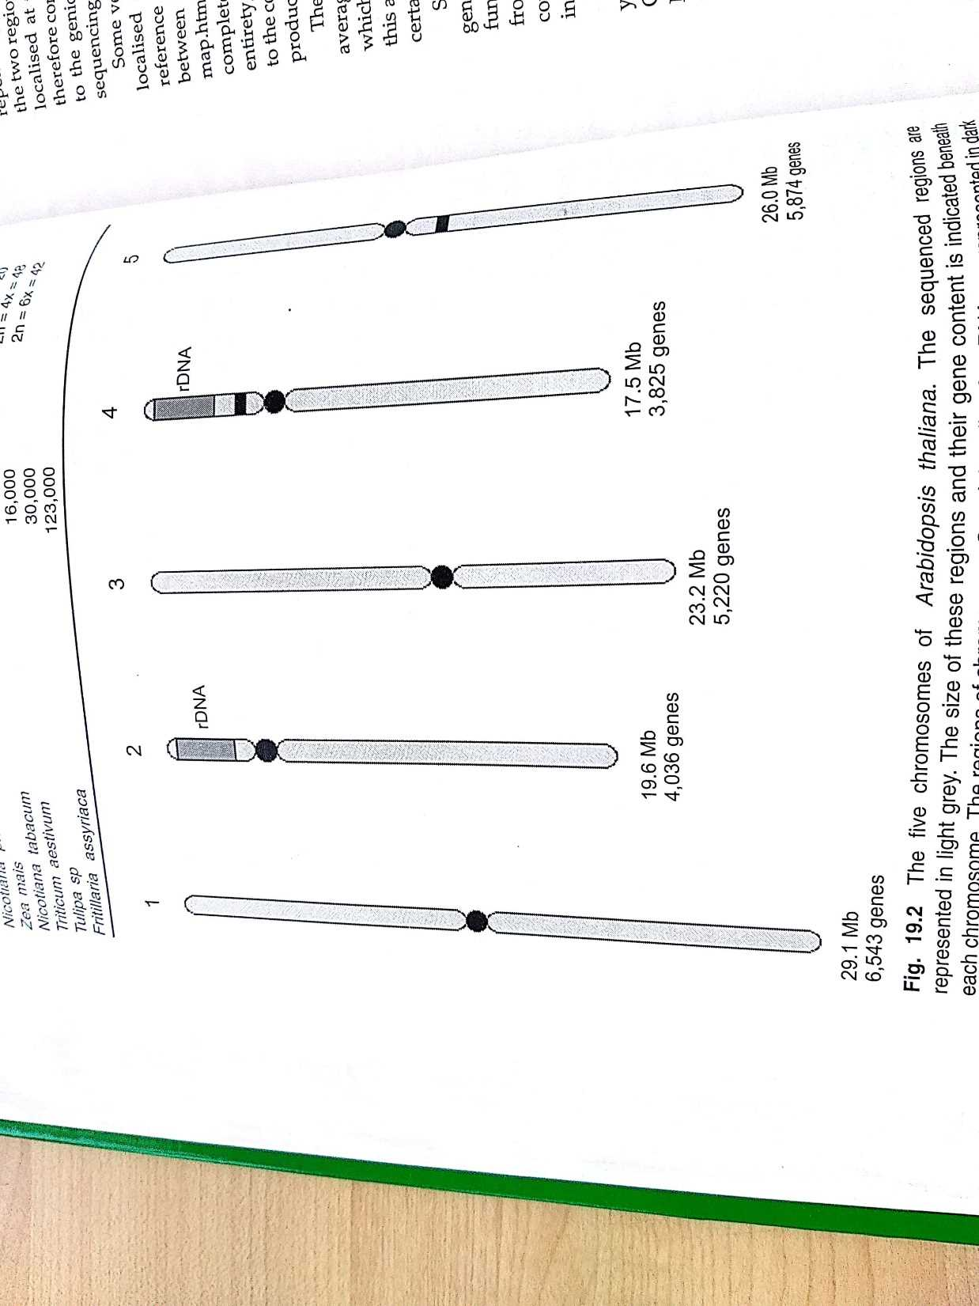
Plant Genome – Arabidopsis thaliana

Slide 11
THANK YOU

